Slide 1
SLOGAN ANALYSIS
Text Analytics
Presented by:
Gilles Bouyer
August 24, 2018

Slide 2

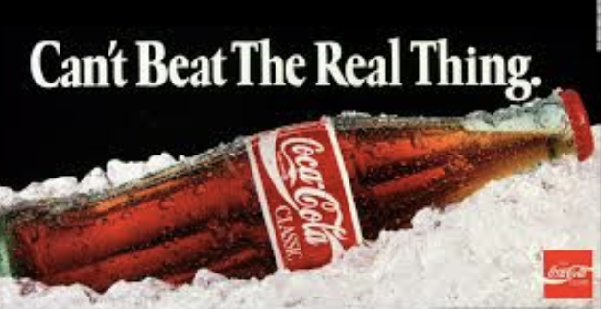


Examples
Gathered 675 slogans
Mostly Dow Jones & S&P

Slide 3
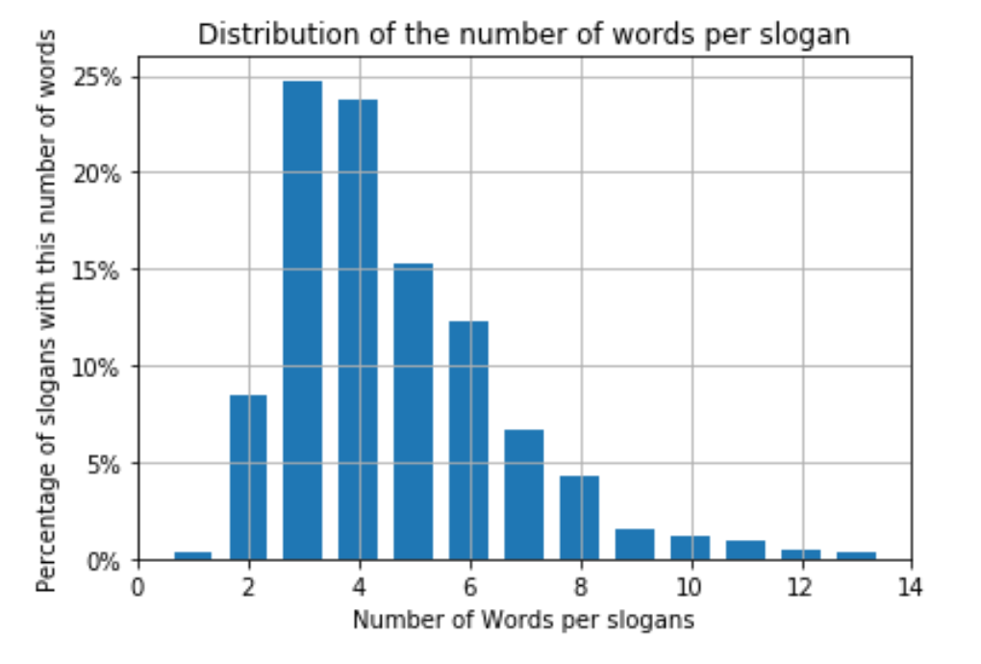
SOME INSIGHTS
~half slogans contains 3 or 4 words

Slide 4
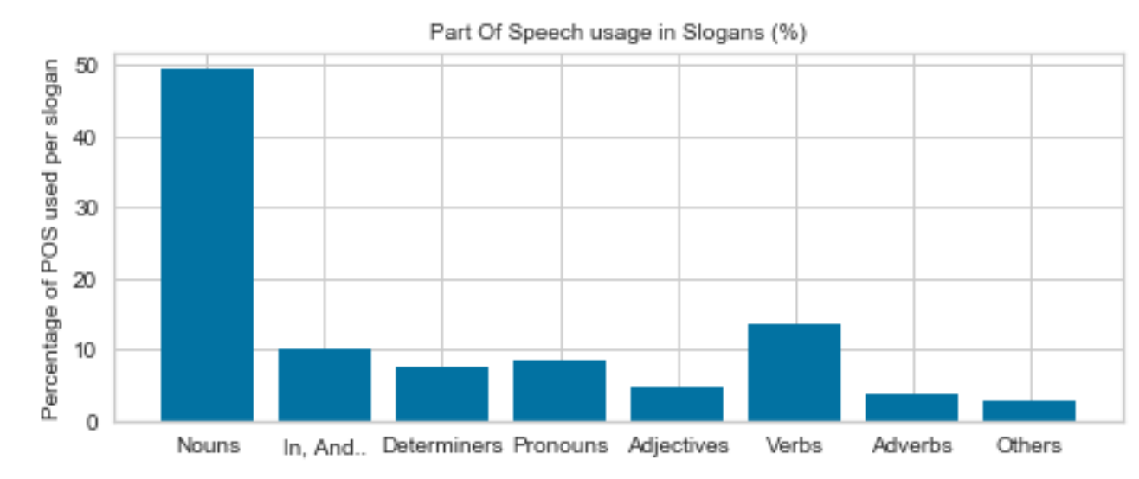
SOME INSIGHTS
Half of the words are nouns
13% are verbs

Slide 5
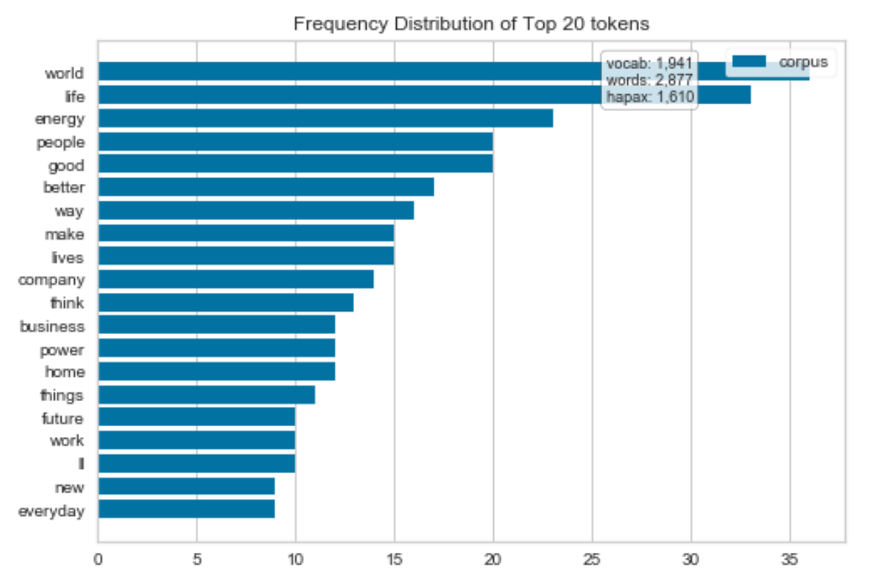
“World” and “Life” are most used

Slide 6
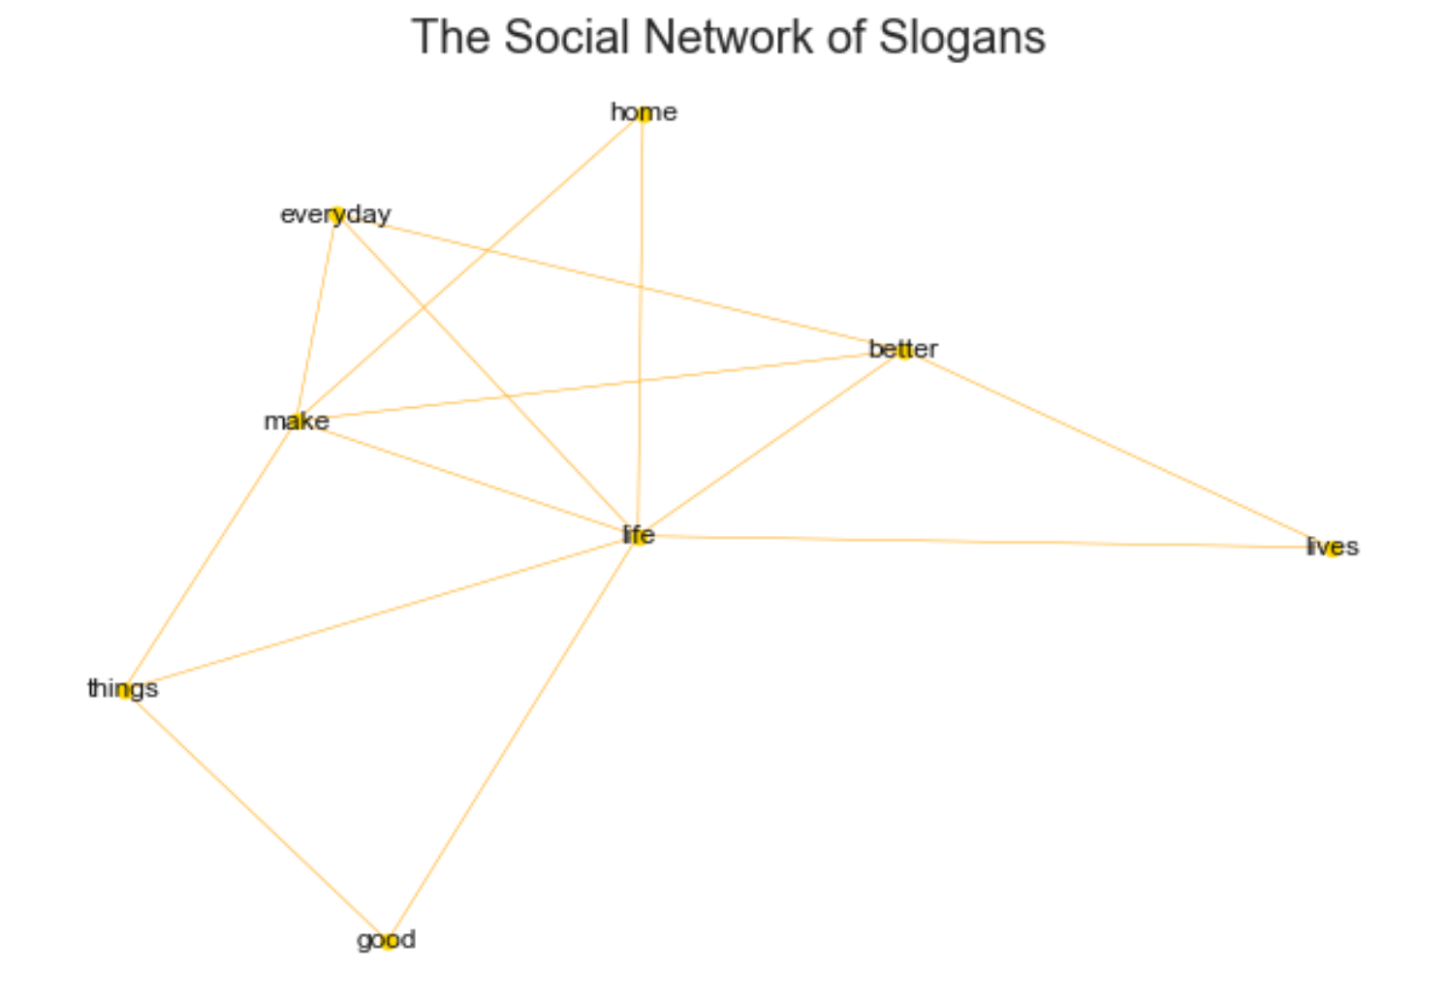
Life is the most social word
Life

Slide 7
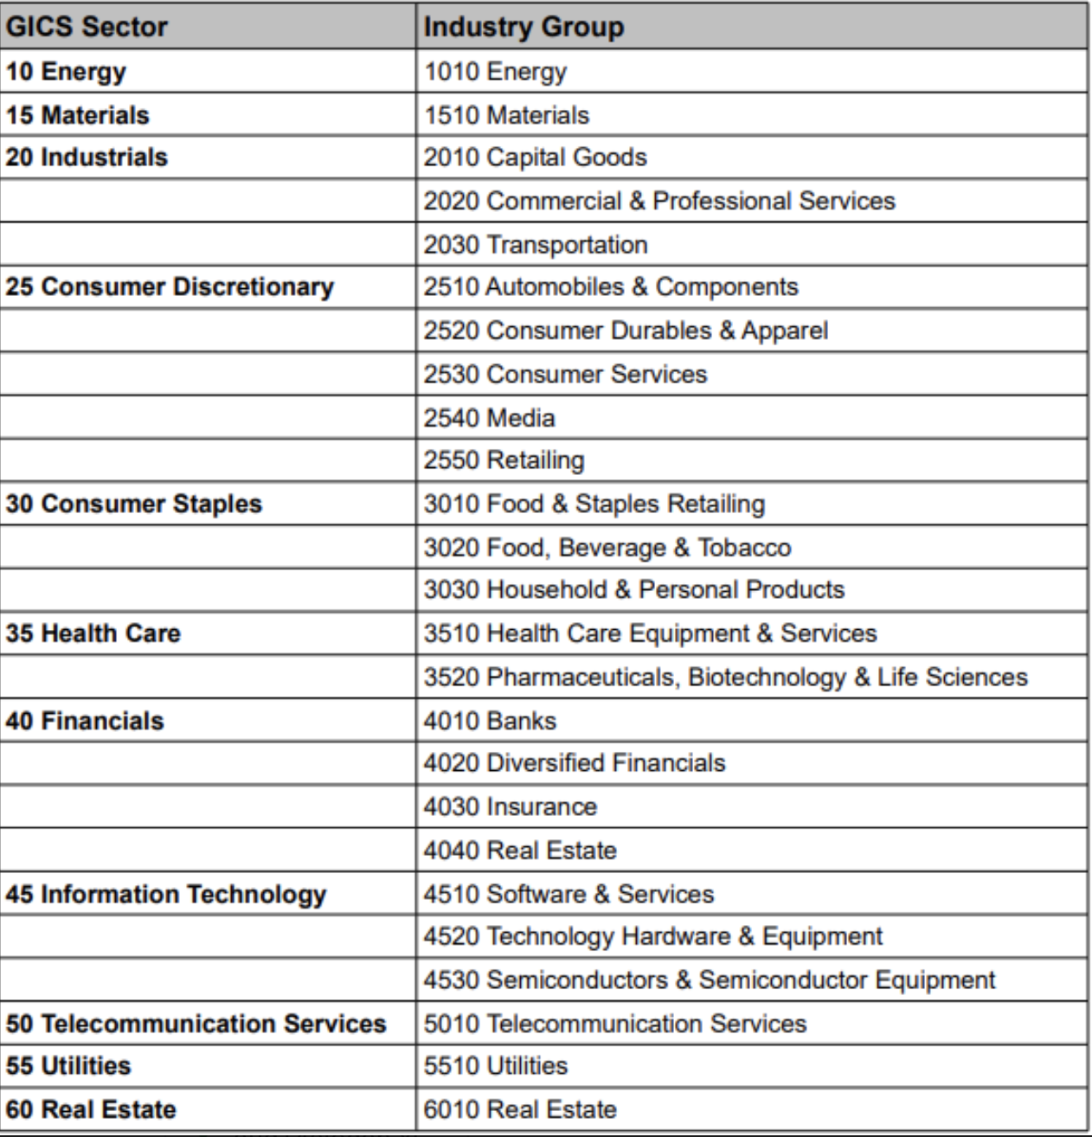
SLOGANS AND GICS
Company classification developed by Standards & Poor’s and MSCI (research)
We build a model to predict which slogans belongs to which type of company

Slide 8
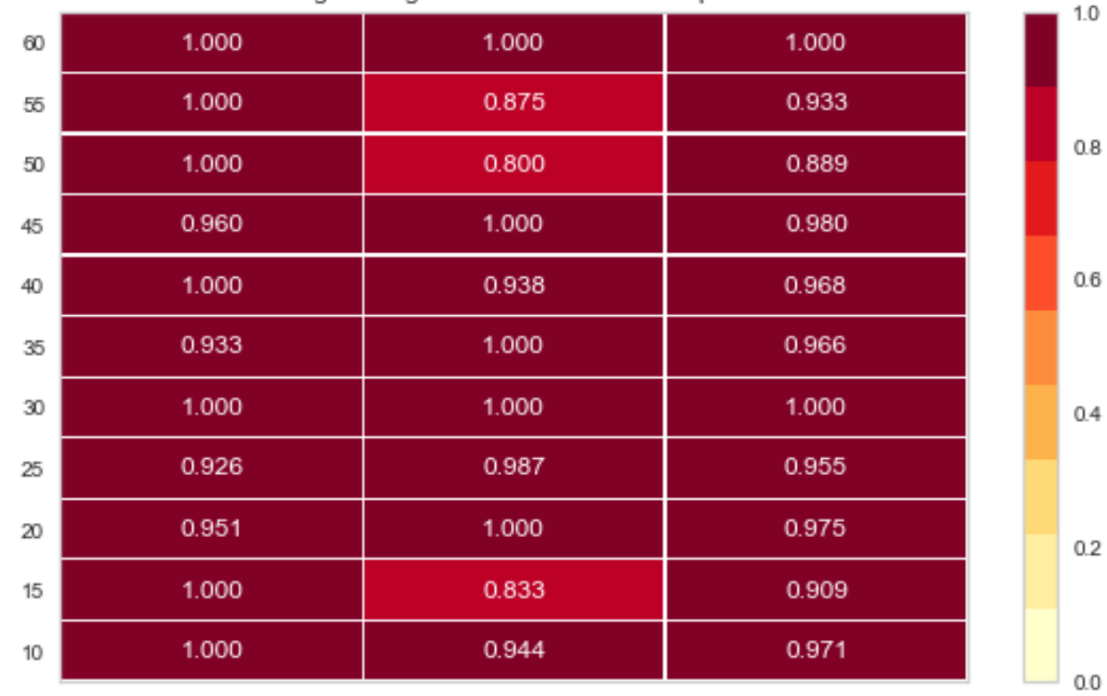
Logistic Prediction Model
Classes
96% score
Precision
Recall
F1

Slide 9
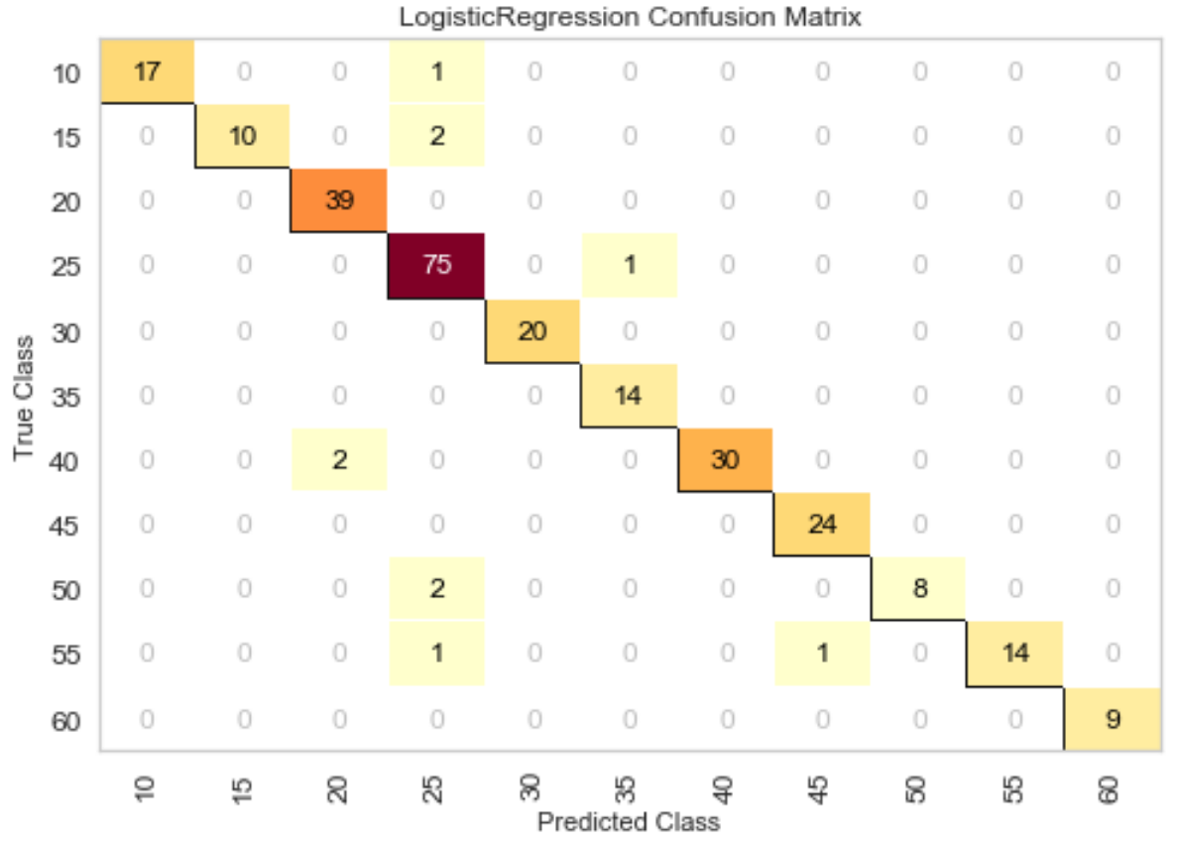
CONFUSION MATRIX

Slide 10
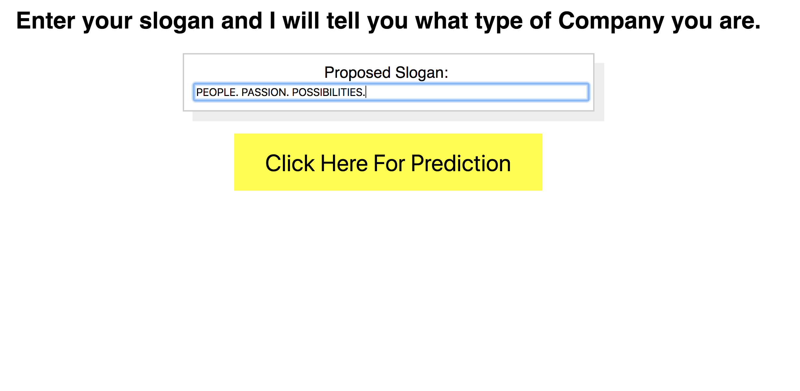
predict the type of company from ITS slogan

Slide 11
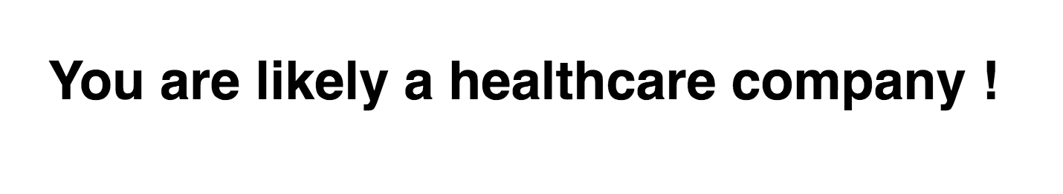
predict the type of company from ITS slogan

Slide 12
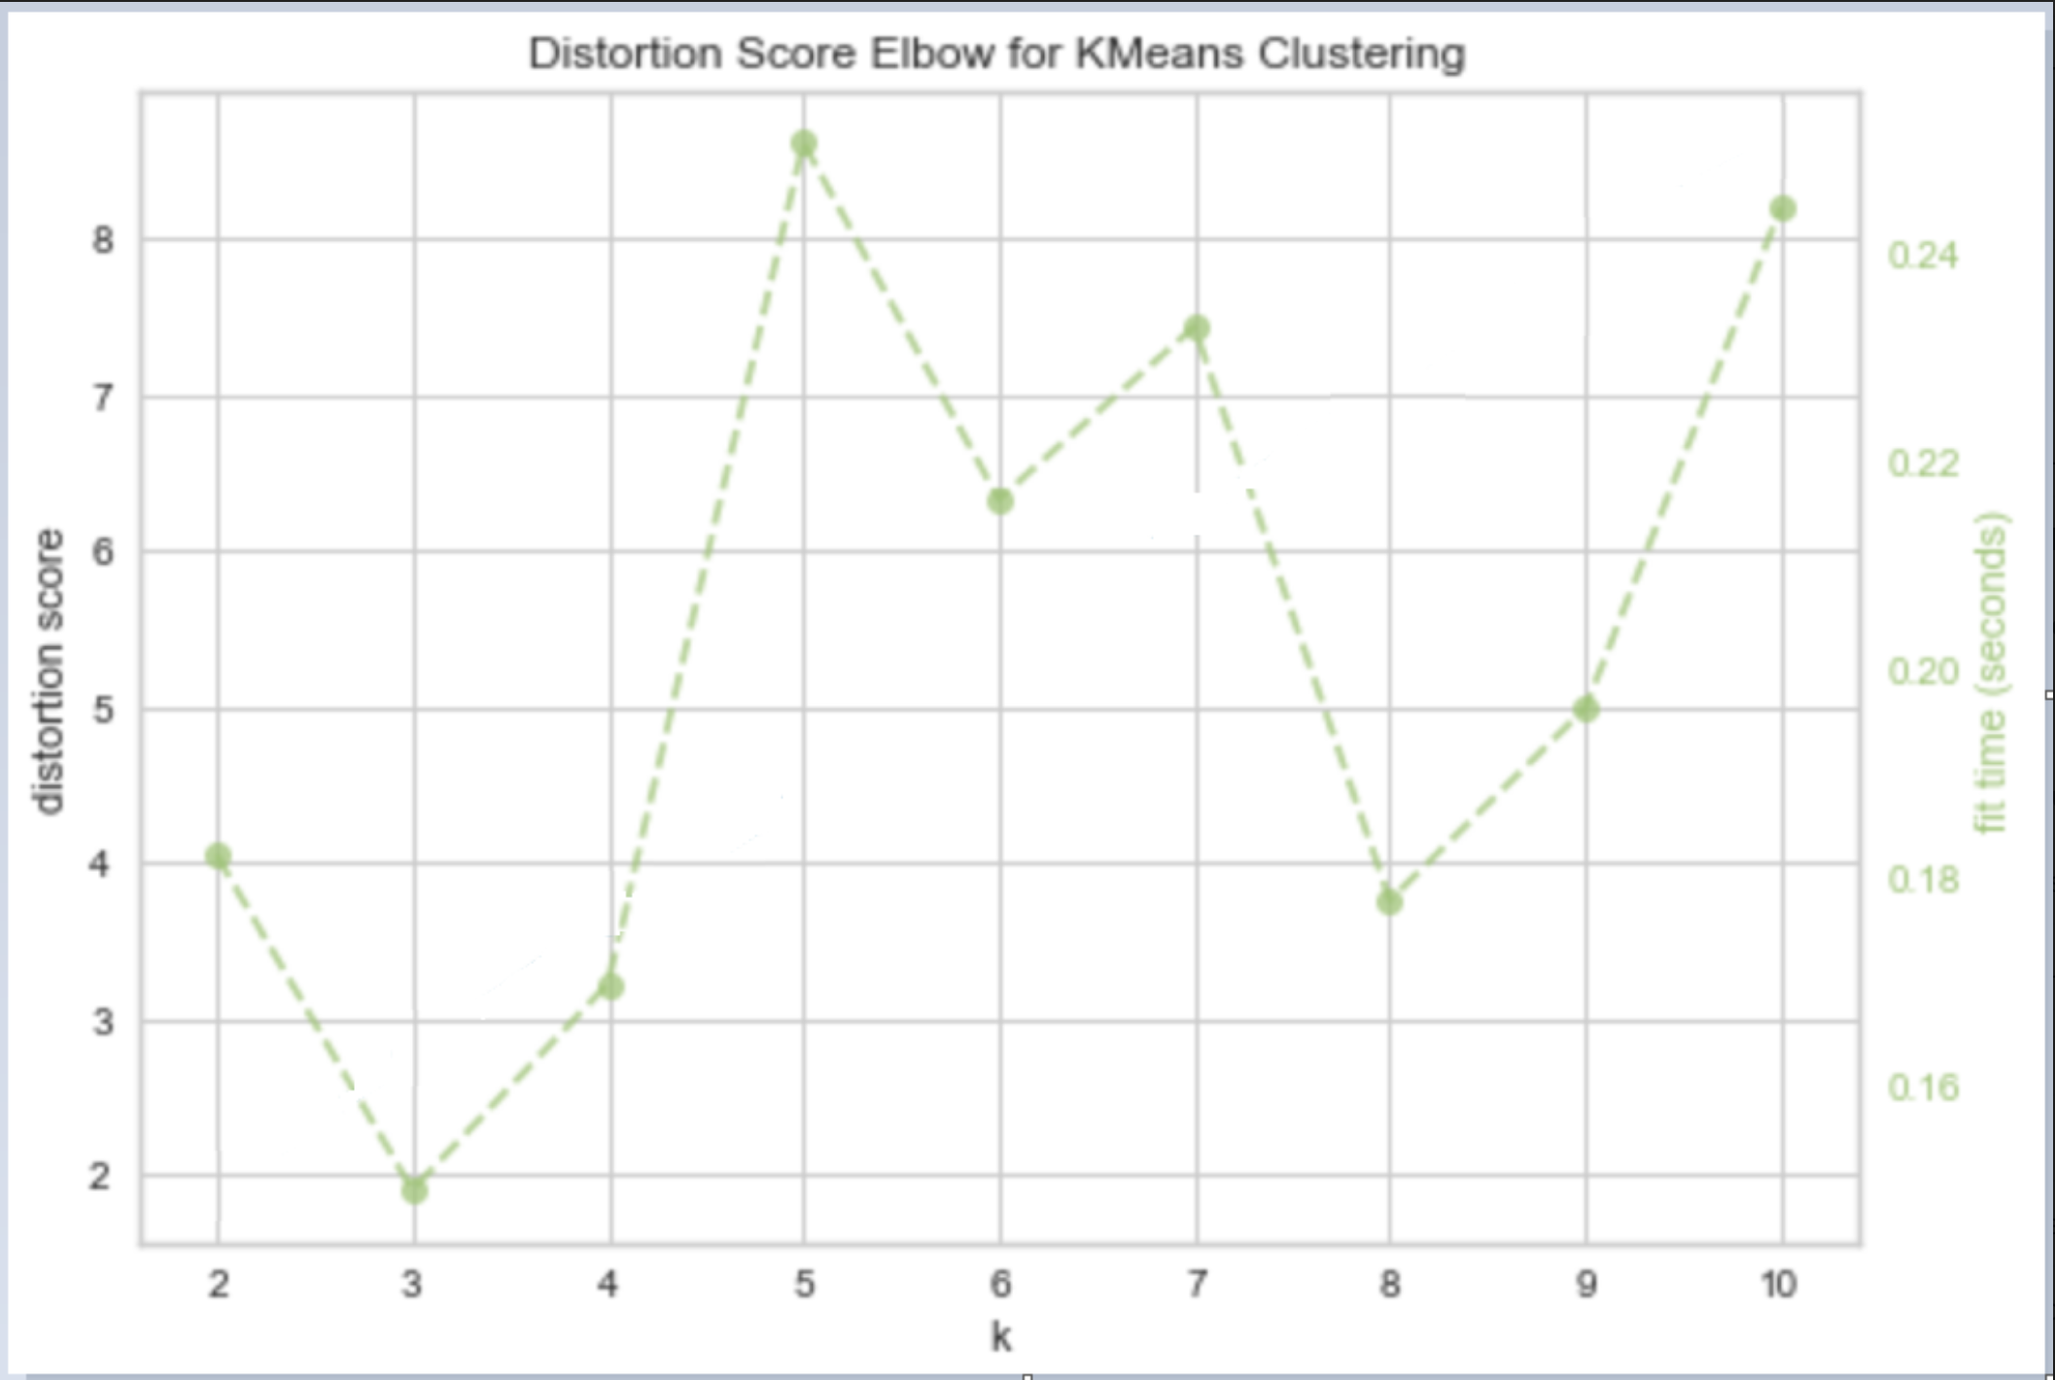

Another way to group slogans ?
Elbow curve indicates there might be 3 clusters

Slide 13
3 cluster research MODELING WITH LDA
Dynamic LDA was run on MongoDB data and identified these 3 topics
Develop
World, better, work, make, company, think, great, protect, things, building
Self
Life, health, fit, let, powered, smart, success, come, water, lives
Values
Way, People, Science, Future, Live, Energy, Home, Value, Money, Help

Slide 14
WE RAN TOPIC MODELING with LSA
It identified guiding principles and inspiration as main topics
Guiding principles
Don’t Be Evil
Don’t Leave Home Without It
Home of the Whopper
Providing Tomorrow’s Energy
Inspiration
Inspiring Progress
Insure Your Vision
From Vision To Reality

Slide 15
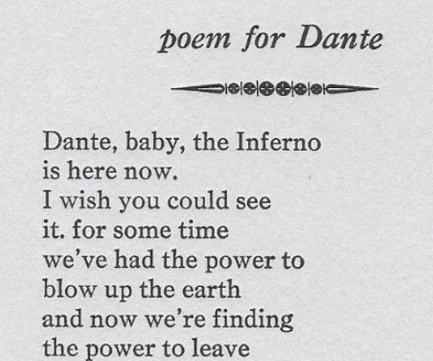
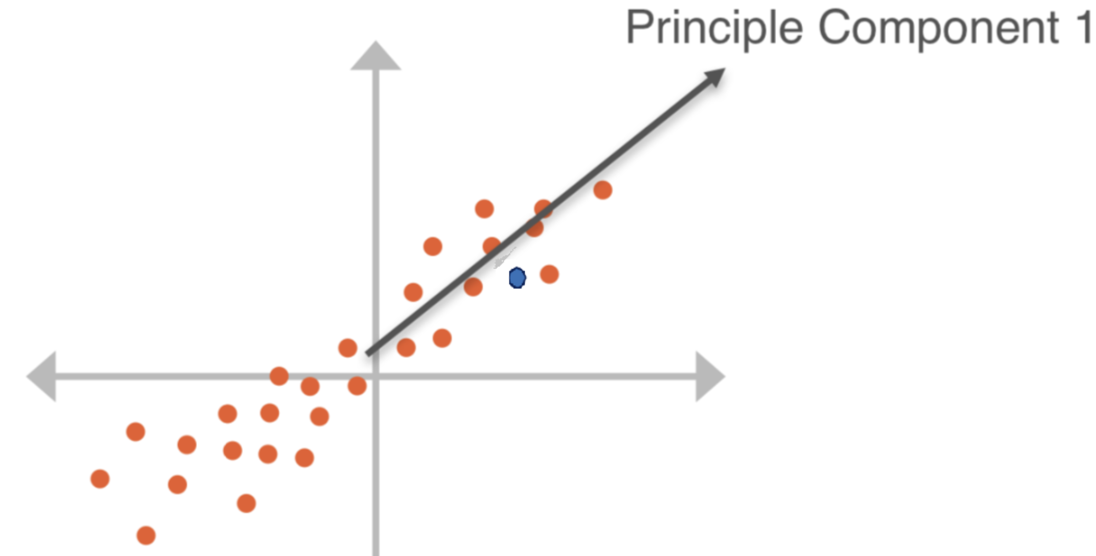
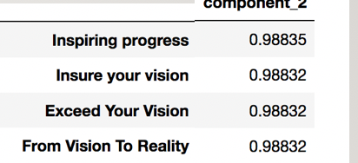
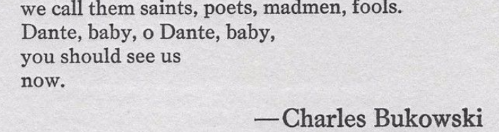
COMPLEment slogans with poetry
Just do it.
LSA
Just do it
Out of there
………………..

Slide 16
COMPLEmenting slogans with poetry
Just do it
Out of there
LSA
Just do it
Out of there
………………..

Slide 17
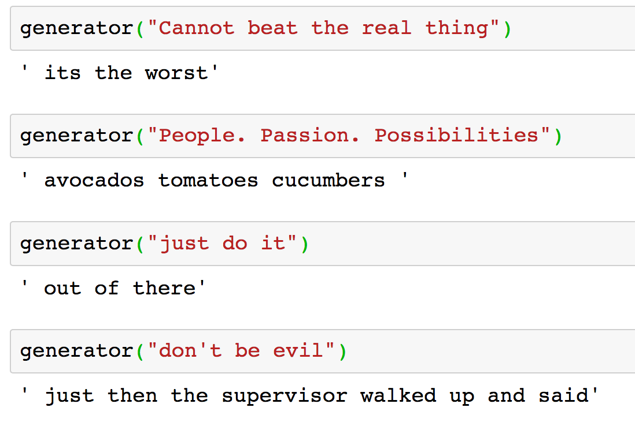
Complementing slogans

Slide 18
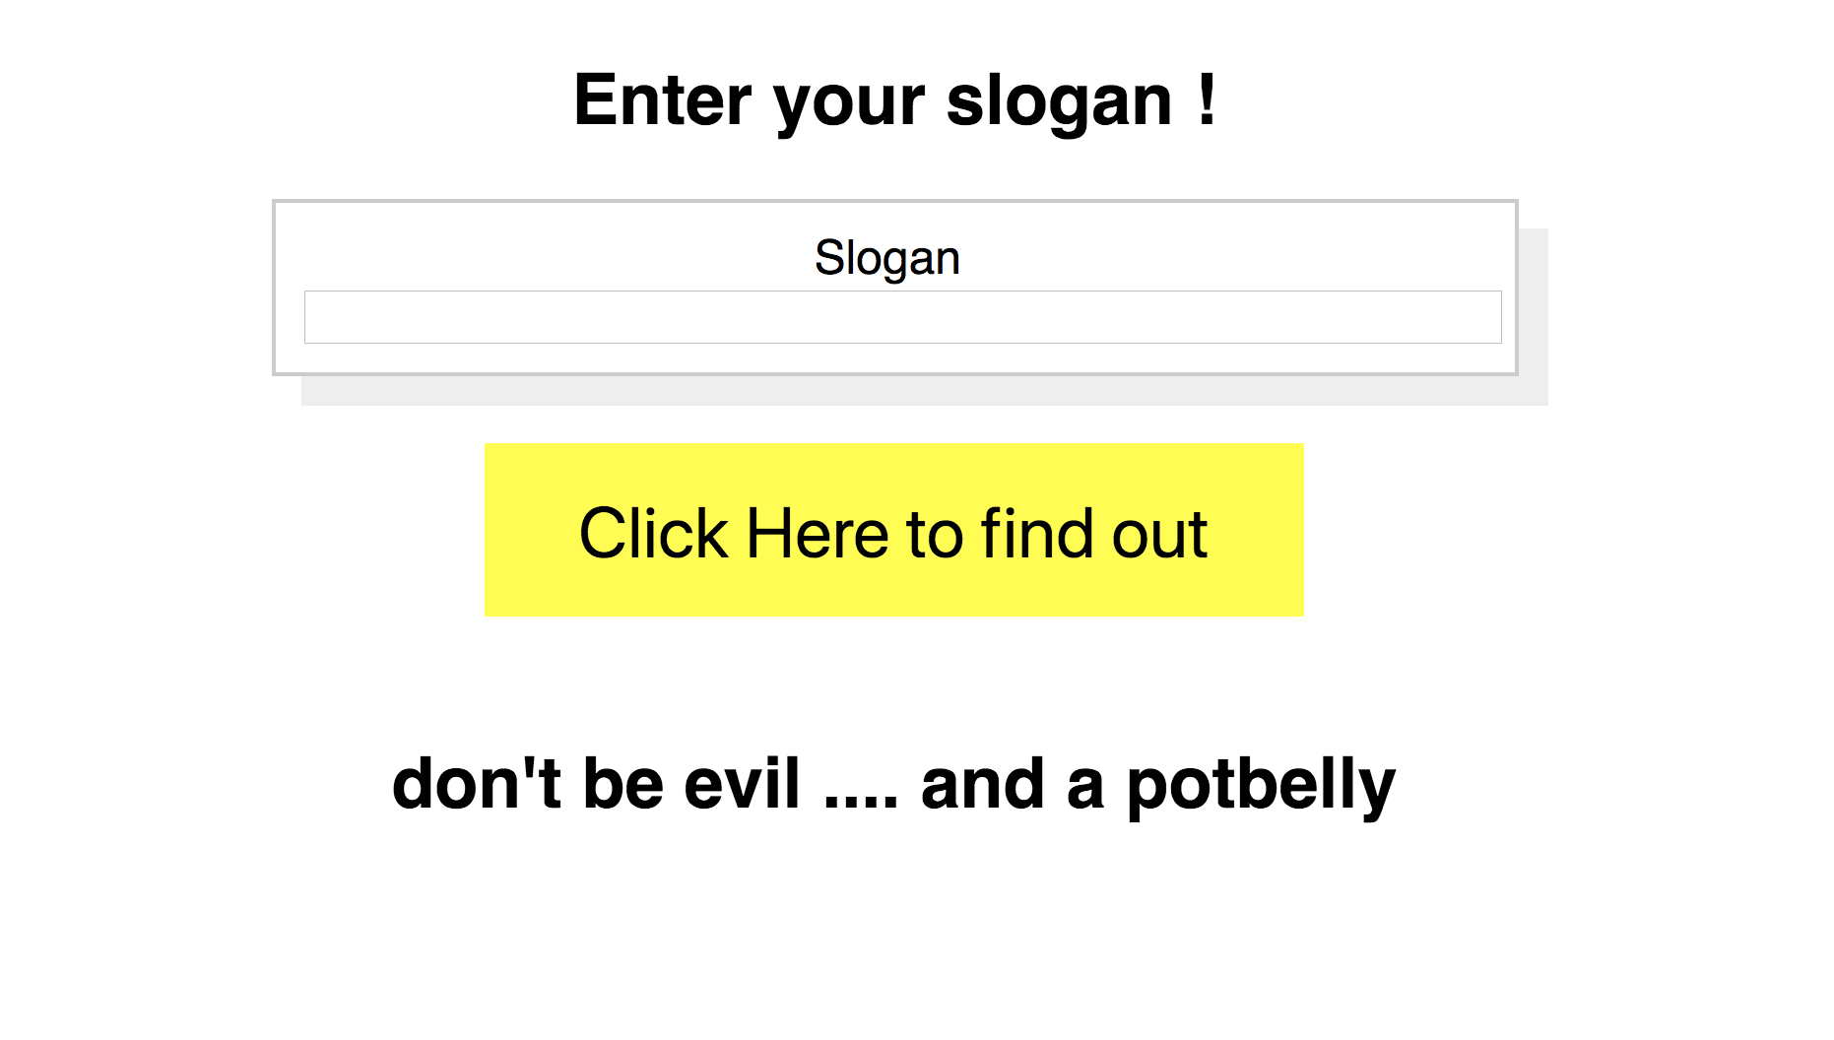
THANK YOU !

Slide 19
THANK YOU !

Slide 20

APPENDIX

Slide 21
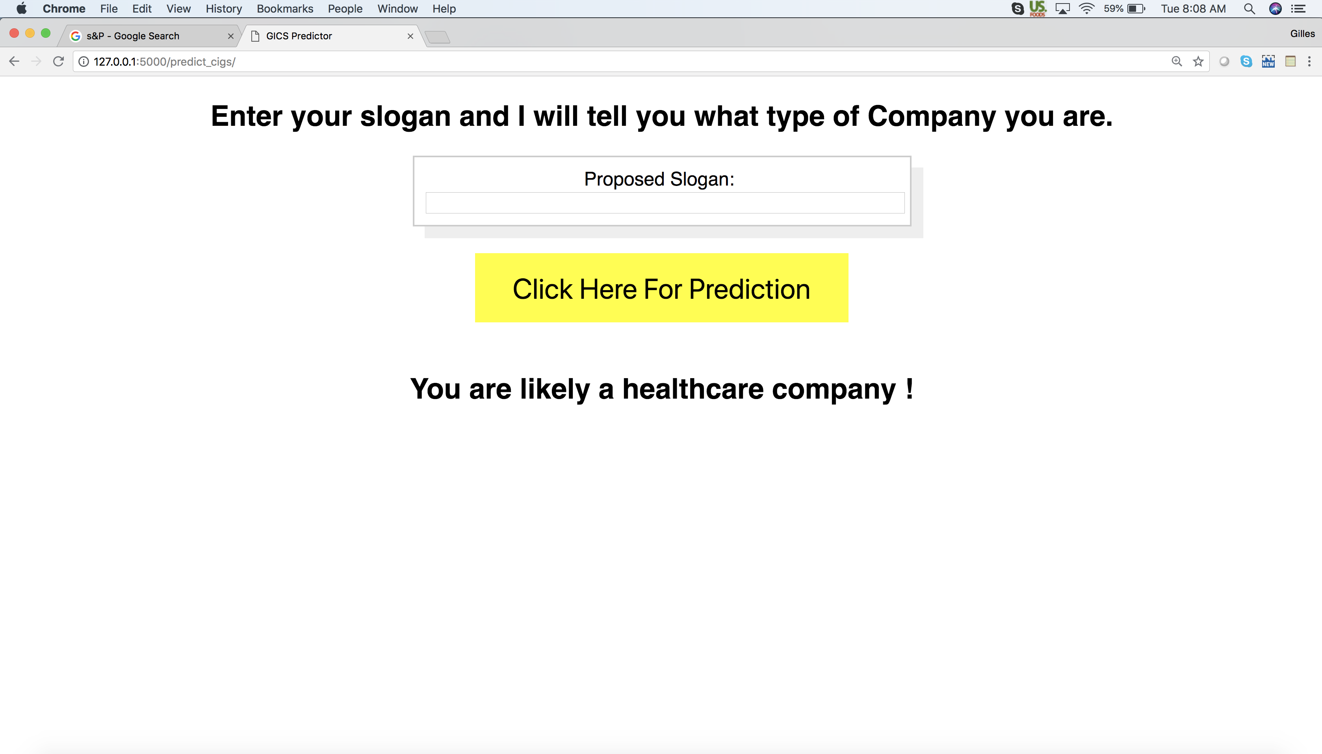

Slide 22
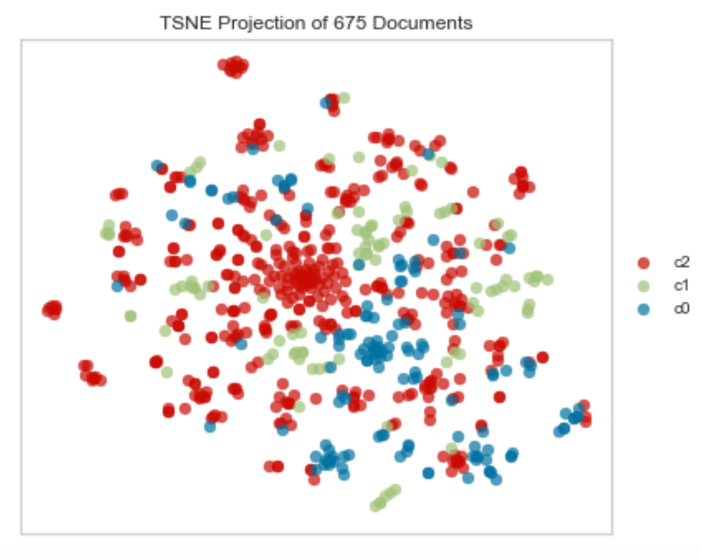
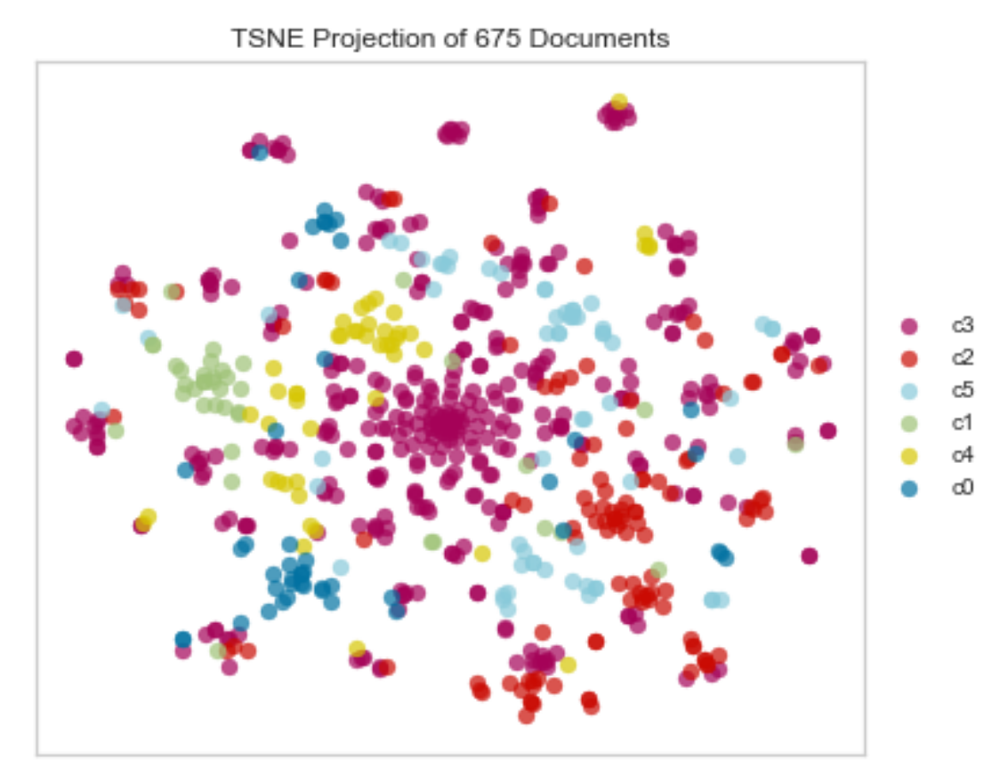
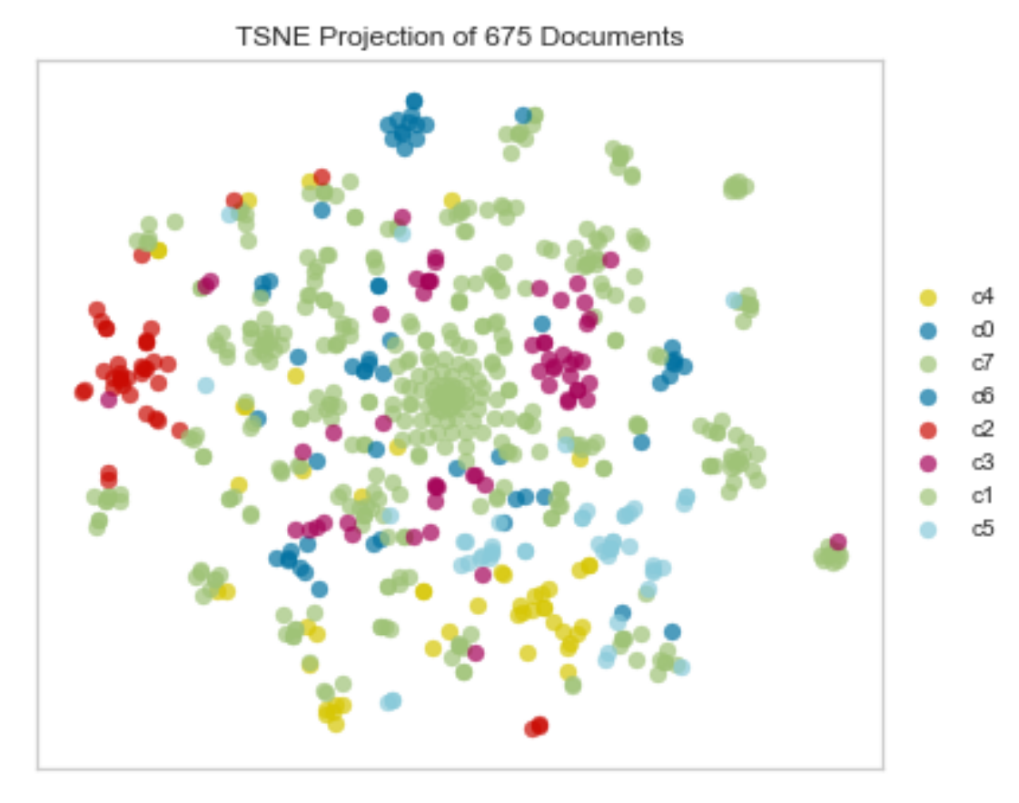
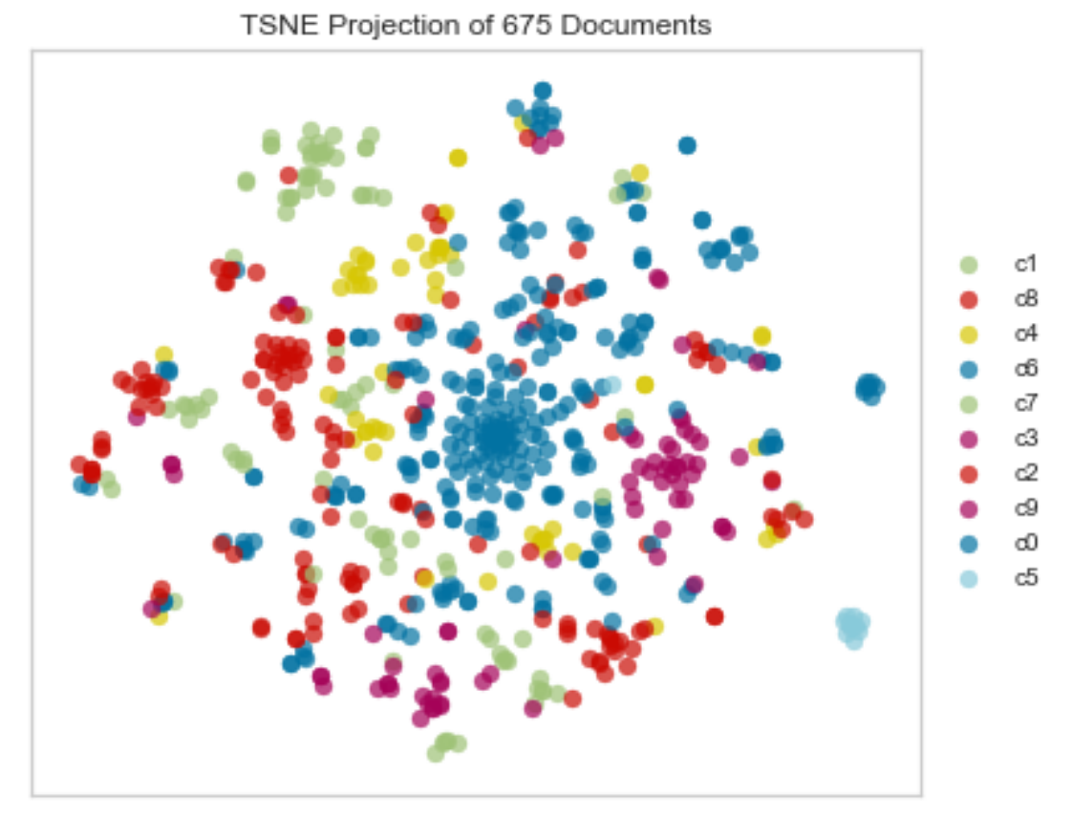
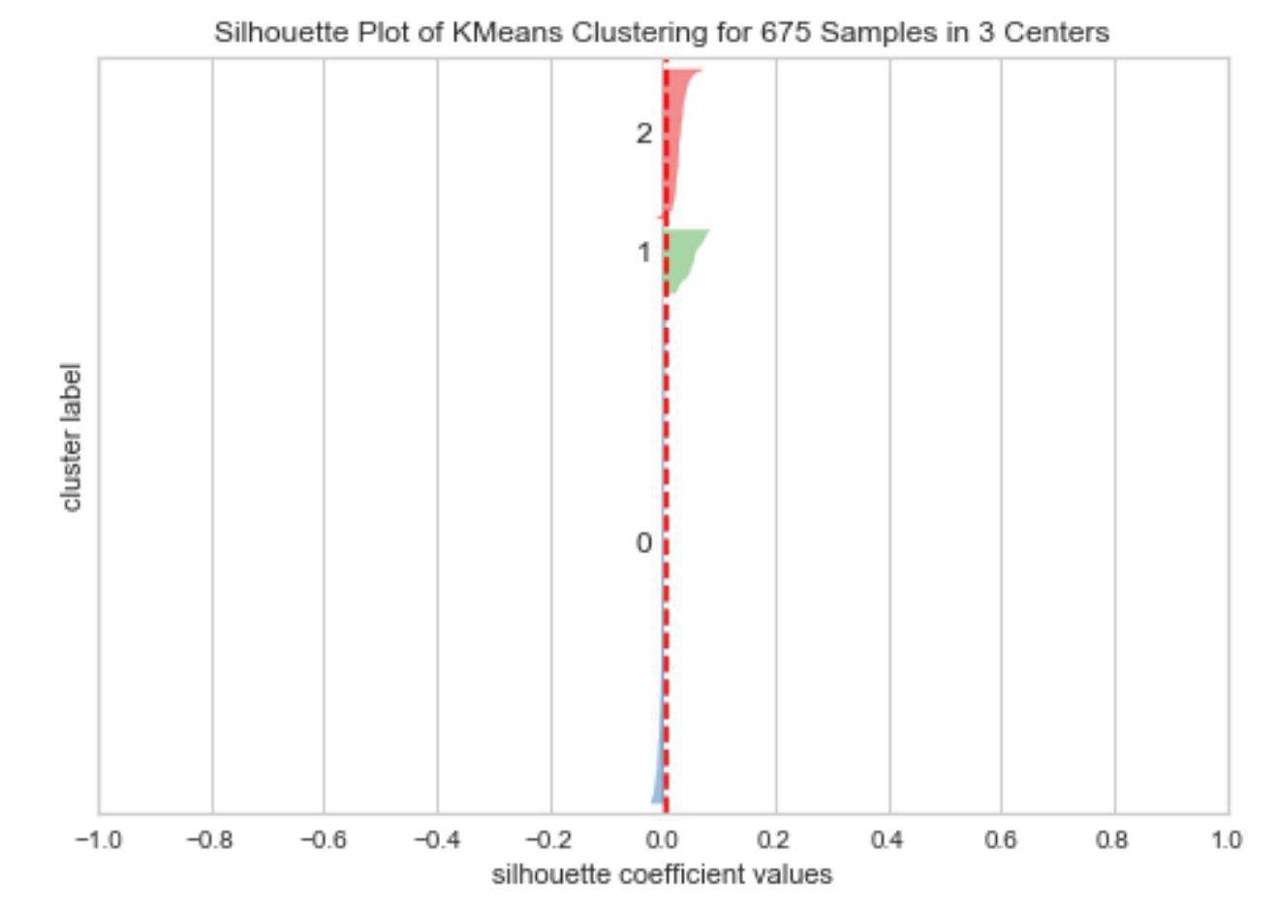
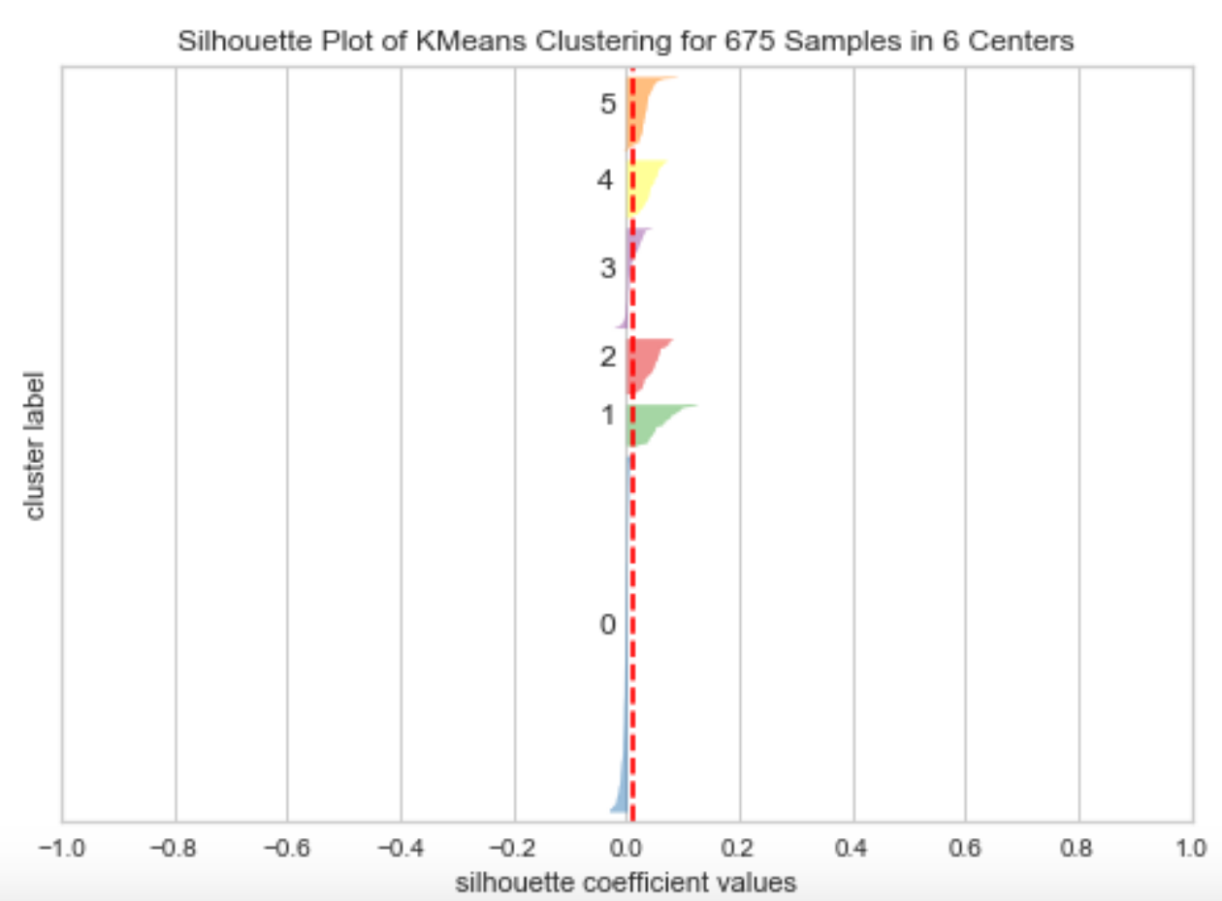
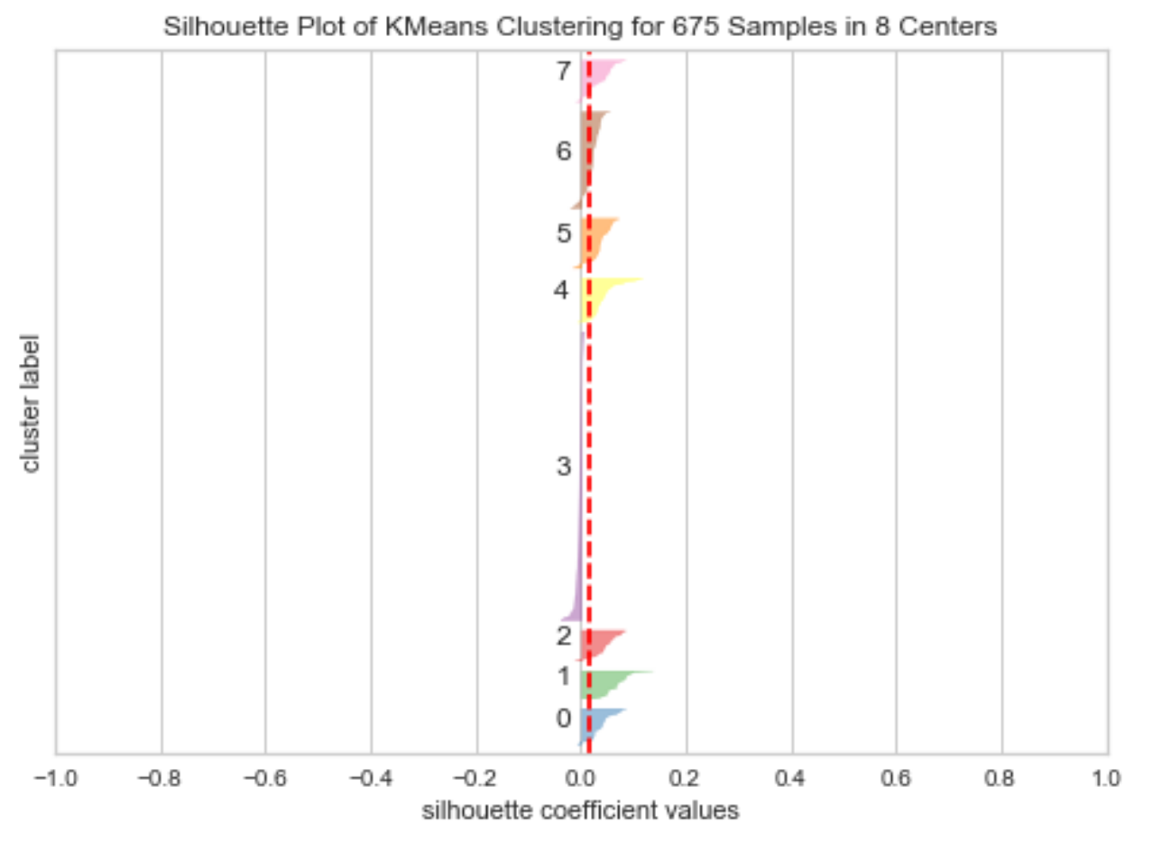
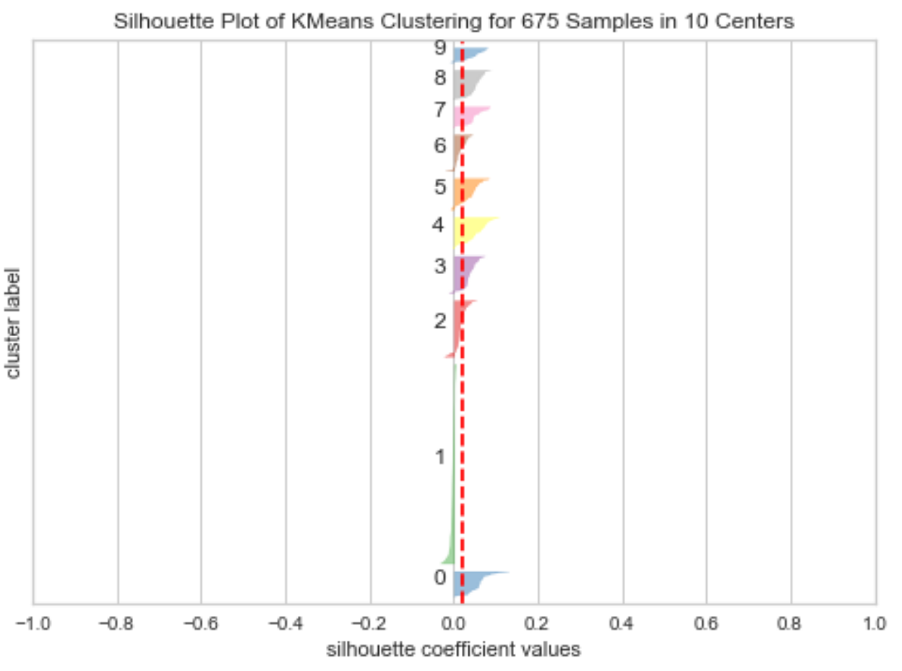
Neighbor Embedding AND SILHOUETTE CURVES
3 Clusters
6 Clusters
8 Clusters
10 Clusters

Slide 23
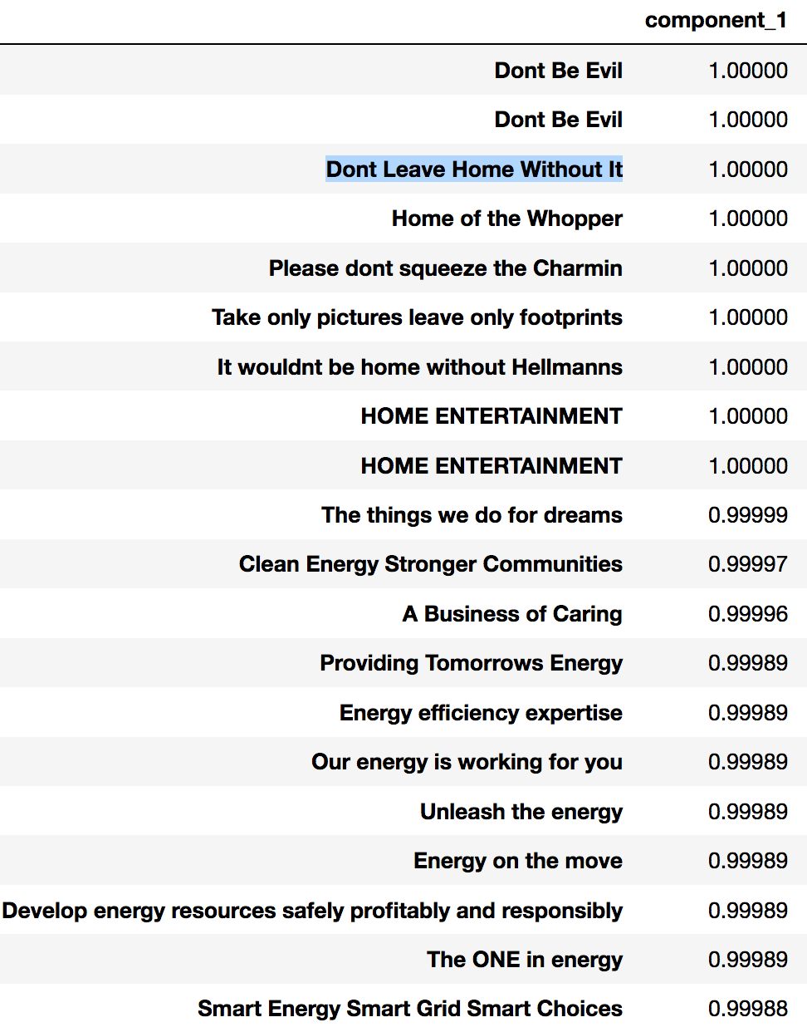
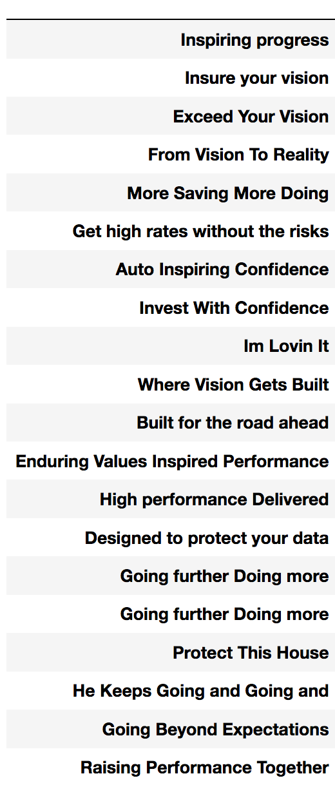
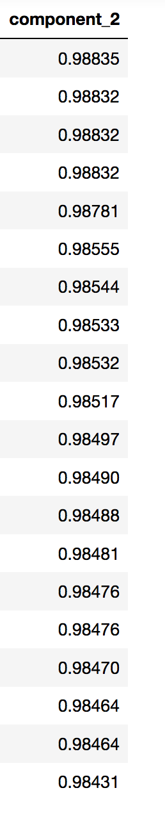
LSA

